Slide 1


U.S. Group
Consolidator, Inc.
Global Logistics & Supply Chain Excellence
INTERNATIONAL FREIGHT FORWARDER • CUSTOMS BROKER

Slide 2


Reliable Logistics Since 1988
Our Vision
Global Advantage
Establishing USG Logistics as the premier global freight partner by delivering integrated transportation, distribution, and NVOCC solutions tailored to the evolving needs of international trade.
As a licensed NVOCC and IATA member, we leverage a robust network across the Pacific and beyond to ensure faster, highly cost-effective, and reliable cargo movement.

Slide 3


A Network Spanning Continents
United States Hubs:
San Francisco (HQ), Los Angeles, New York, Chicago, Minneapolis.
Asia-Pacific Reach:
China (8 branches), Hong Kong, Taiwan, South Korea, Vietnam, Singapore, Cambodia, Indonesia, Thailand.
Global Partners:
Strategic agencies in every major port worldwide.

Slide 4






Air Freight: Speed Without Compromise
Daily Consolidations
Expedited Service
DG Handling
Tailored solutions for time-critical shipments including NFO and priority uplift.
Certified personnel equipped to manage hazardous and dangerous goods safely.
Frequent, reliable consolidations to primary global destinations at competitive rates.

Slide 5
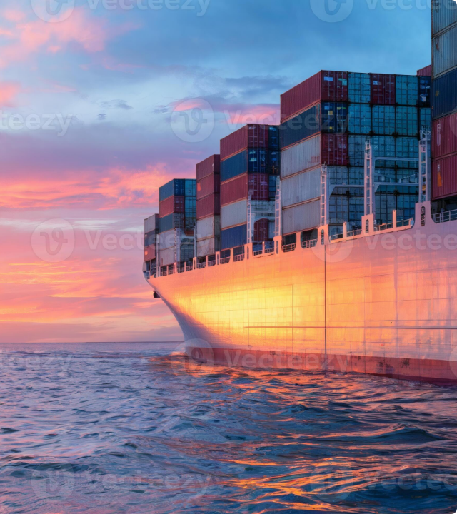
Ocean Freight Mastery
We provide comprehensive NVOCC solutions, securing transport space across all major steamship lines to ensure your cargo moves on schedule.
•
FCL (Full Container Load)
•
LCL (Less-than-Container Load)
•
Project Cargo & Breakbulk
•
Vessel Chartering Services

Slide 6
Customs Brokerage & Compliance
Full Entry Services: Expertise in complex import/export documentation and duty classifications.
CTPAT Certified: Partnering with CBP to ensure higher security and faster processing times.
Regulatory Liaison: Acting as your bridge to all government agencies for smooth clearance.
Duty Optimization: Identifying opportunities for drawback and tax mitigation strategies.

Slide 7


3PL Warehousing & Distribution
Integrated Storage
Our secure facilities offer flexible storage and value-added services to streamline your supply chain.
•
Inventory Management & Visibility
•
Pick-and-Pack & Kitting Services
•
Cross-Docking & Transloading
•
Long-term and Short-term Storage

Slide 8

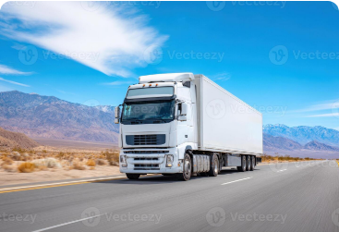

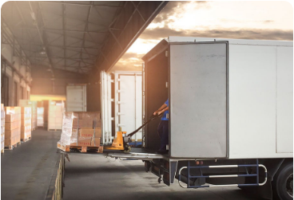

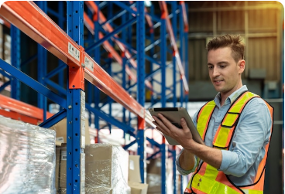
Domestic Trucking & Logistics
Nationwide Hauling
Drayage & Pier Pick-up
Last Mile Delivery
Localized distribution ensuring timely arrival for final consumers.
Reliable FTL and LTL services across the continental U.S.
Efficient container movement from major ports to your door.

Slide 9
The Value of Partnership
Why USG Logistics?
35+
We combine over three decades of industry knowledge with cutting-edge tracking technology to keep your cargo moving without delay. Our IATA membership and CTPAT partnership signify our commitment to the highest global standards.
Years of Experience
Competitive rates. Reliable service. Absolute visibility.

Slide 10
“
Our customers are always our top priority, and we endeavor to deliver on our service promise—every time.
— Leadership, U.S. Group Consolidator, Inc.

Slide 11
Questions?
Let's streamline your global supply chain today.
www.usgroupconsol.com
55 Walnut St Suite 203B Norwood, NJ 07648
(862) 484-8180
U.S. GROUP CONSOLIDATOR, INC. | USG LOGISTICS, INC.

